Slide 1
Living Environment of Toronto City Neighbourhoods
24 Feb 2020

Slide 2
Problem Statement
In 2020 November, Canada announced a 3-year open work permit and immigration pathway for Hong Kong residents. The policy has drawn strong attention of Hong Kong youths who are desperate for an immediate move.
This research aims to study the living environment of Toronto City, the most prominent metropolis of Canada.
Target audience: Hong Kong residents who decided to make a hasty trip to Toronto but have not determined a suitable place to settle down.

Slide 3
Research Objectives
Overview of the latest house price by house types and the price trend of Toronto City
Population distribution of major ethnics in the 140 Toronto City neighbourhoods
Exploration of livable neighbourhoods in terms of community environment and safety

Slide 4
Data Source
Wikipedia : listing of postal codes and neighbourhoods
Geocode Python : postal codes latitude and longitude coordinates
Toronto Open Data Portal :
Toronto City's Neighbourhood geojson file
Statistics of visible minority population
Kaggle :
Toronto House Price information originated from the TRREB
Foursquare API : explore neighbourhoods’ nearby venues

Slide 5
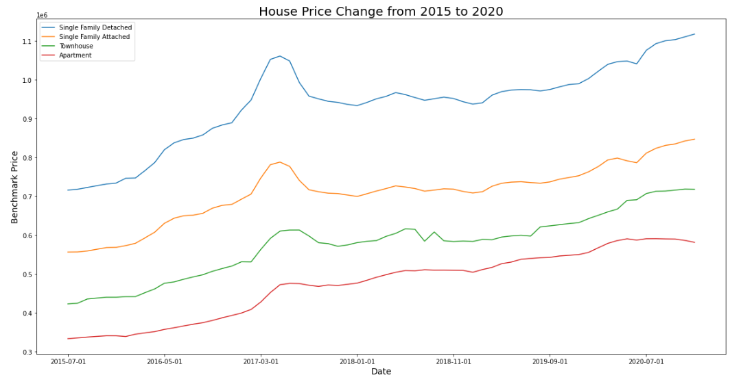
House Price Trend (2015 – 2020)
Insights:
Overall upward trend in past 5 years.
Apartment appears to have a downward tendency begins from 2020.
Townhouse’s rise is flattening.

Slide 6
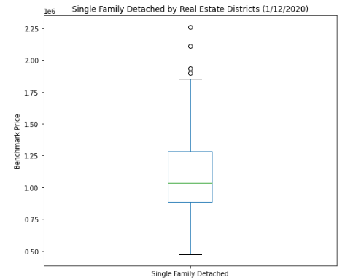
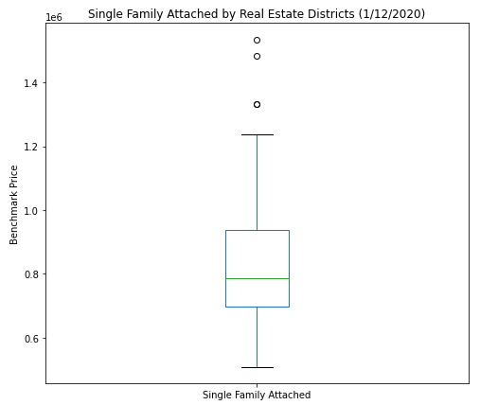
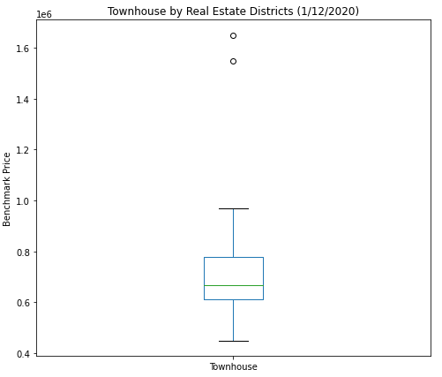
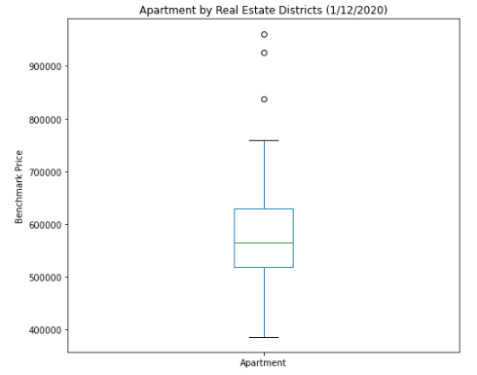
House Price by Type (as of Dec 2020)
House Type | Mean Price (CAD) | Standard Deviation from Mean (CAD)
Single Family Detached | 1,117,861 | 362,338
Single Family Attached | 847,203 | 231,099
Townhouse | 718,222 | 216,818
Apartment | 581,382 | 117,570

Slide 7
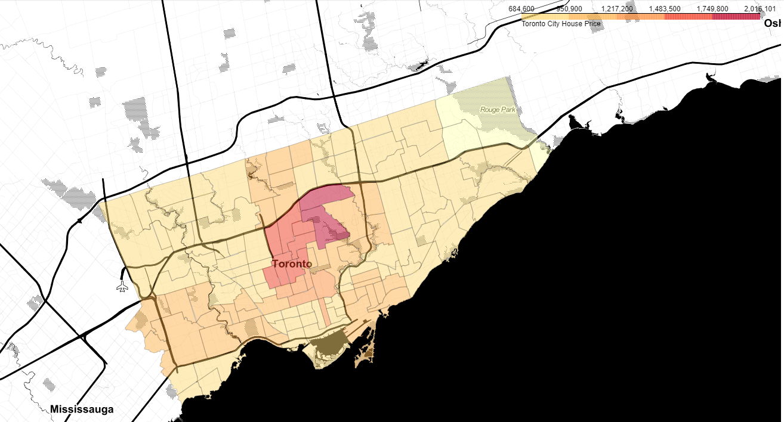
House price by NeighbourHoods (DEC 2020) - Choropleth MAP
Forest Hill North
Lawrence Park North
Lawrence Park South
Bedford Park-Nortown
Englemount-Lawrence
St.Andrew-Windfields
Bridle Path-Sunnybrook-York Mills
Forest Hill South
Yonge-Eglinton
Humewood-Cedarvale
Oakwood Village

Slide 8
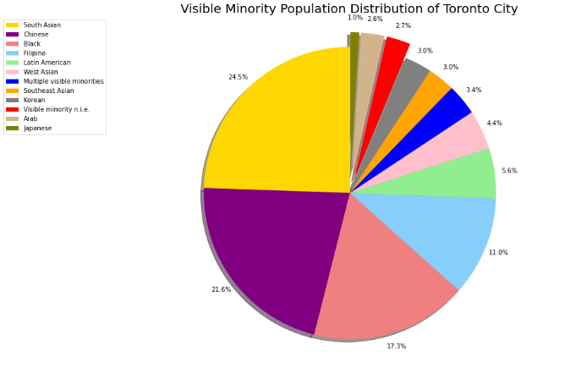
Ethnics Population
According to 2016 census profile, of Toronto City's population, 51.49% are visible minorities.
South Asian, Chinese and Black are the 3 biggest ethnic groups, contributing to about 33% of 2.9M Toronto City total population.

Slide 9
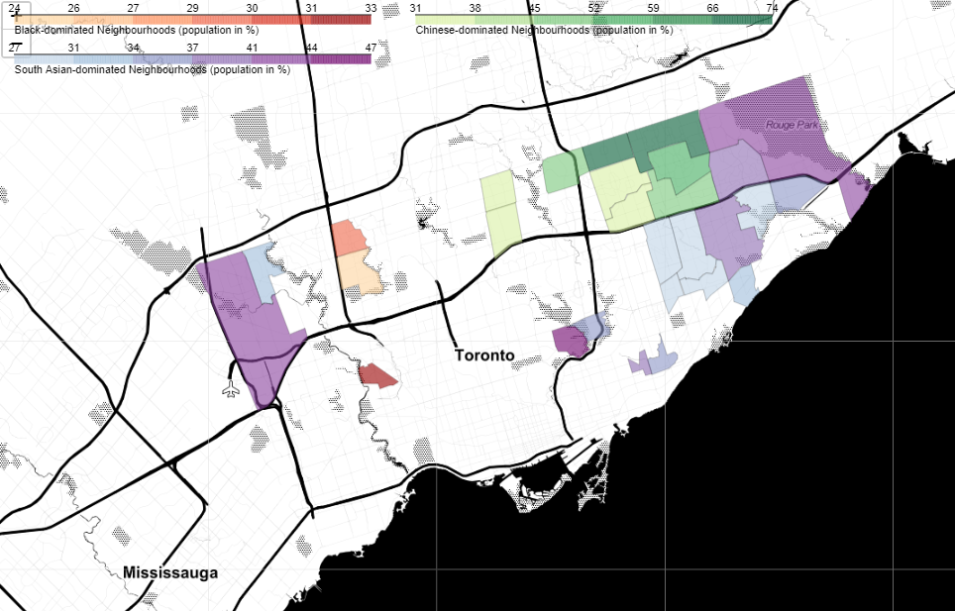
Minority Dominated Neighbourhoods - Choropleth MAP
In 27 out of the total 140 neighbourhoods, residency % from a single ethnic outreaches that of the aboriginals

Slide 10
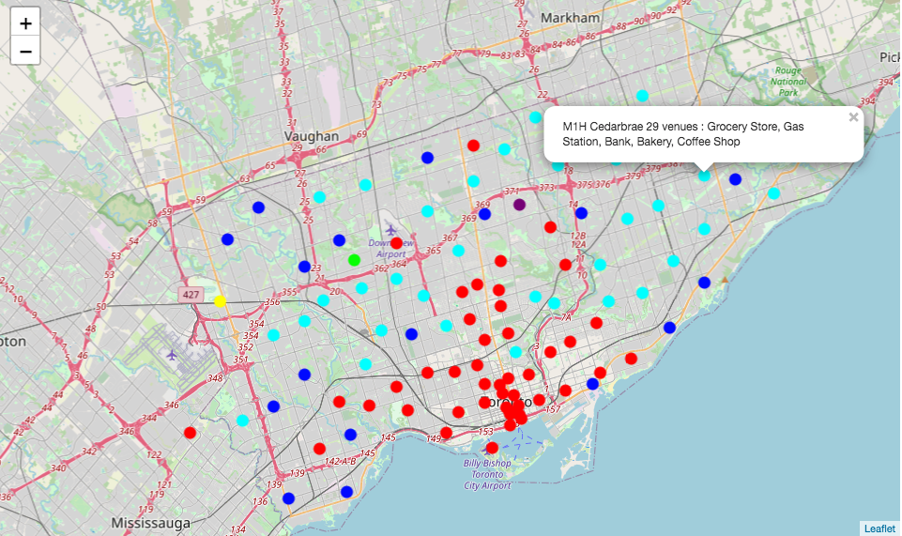
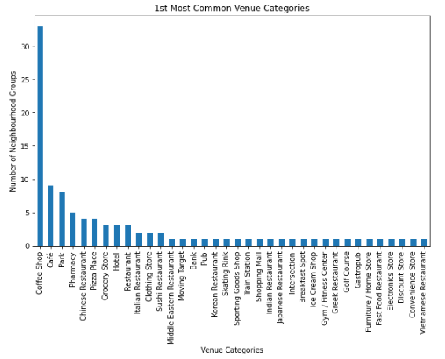
Neighbourhoods K-mean Clustering (by Venues Categories) - Folium MAP
In 1km Proximity:
3625 unique venues
339 unique categories
6 CLUSTERS:
RED
CYAN
BLUE
LIME
YELLOW
PURPLE

Slide 11
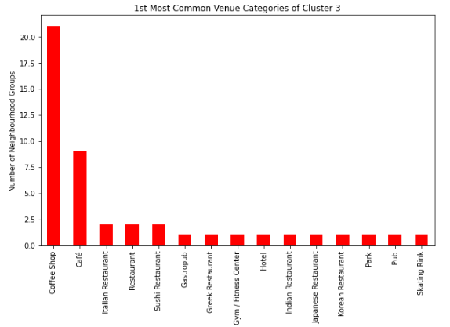
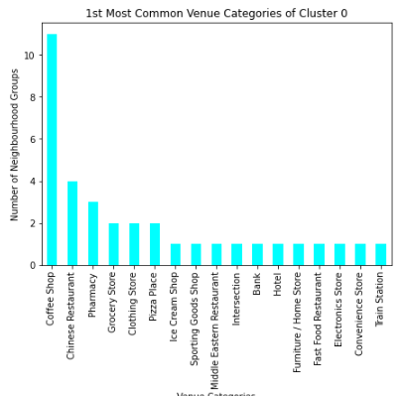
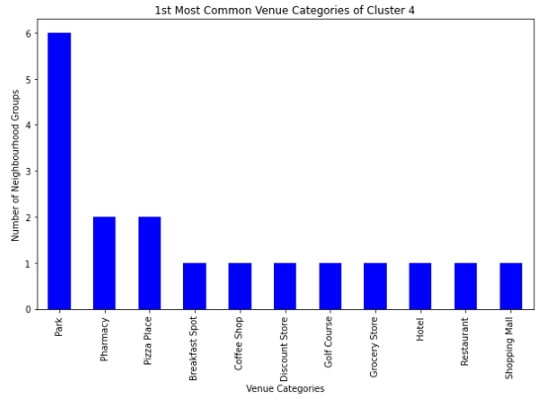
Major Neighbourhoods Clusters
Red Cluster
Coffee shop and cafe are highly centralized and largely located along Yonge Street.
Wide variety of international cuisines.
Others - park and hotel
Cyan Cluster
Coffee shop is still the 1st most common venue
Fair variety of dining options among which chinese restaurant stands out.
Wide variety of merchandizes including pharmacy, grocery store, clothing store, furniture store, electronics store, convenience store.
Others – bank, hotel, train station, intersection
BLUE Cluster
An abundance of parks
Large leisure venues - discount store, shopping mall and golf course
Others - hotel

Slide 12
Outlier Neighbourhoods
3 clusters comprise of only one neighbourhood each
Only 3 to 4 venues are discovered
Lime Neighbourhood 2 Vietnamese restaurant, 1 Baseball Field, 1 Restaurant
Purple Neighbourhood 1 Pool, 3 Parks
Yellow Neighbourhood 1 Coffee Shop, 1 Lounge, 1 Moving Target

Slide 13
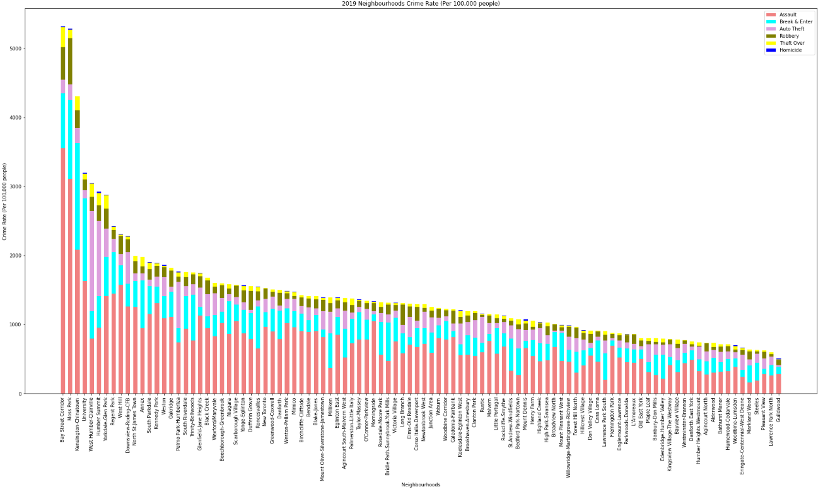
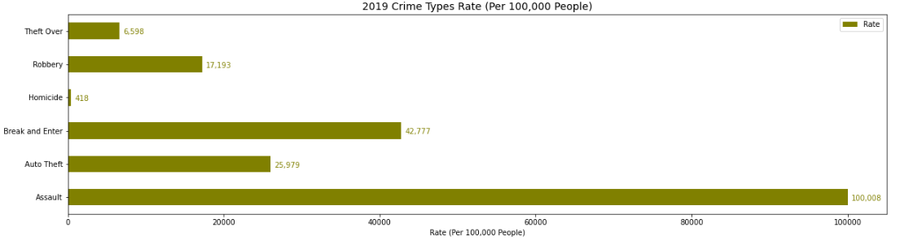
Crime Rate (by Types & Neighbourhoods)
From high to low crime rate:
Assault
Break and Enter
Auto Theft
Robbery
Theft Over
Homicide
West Humber-Clairville, Humber Summit and Pelmo Park-Humberlea have exceptionally high auto theft rate

Slide 14
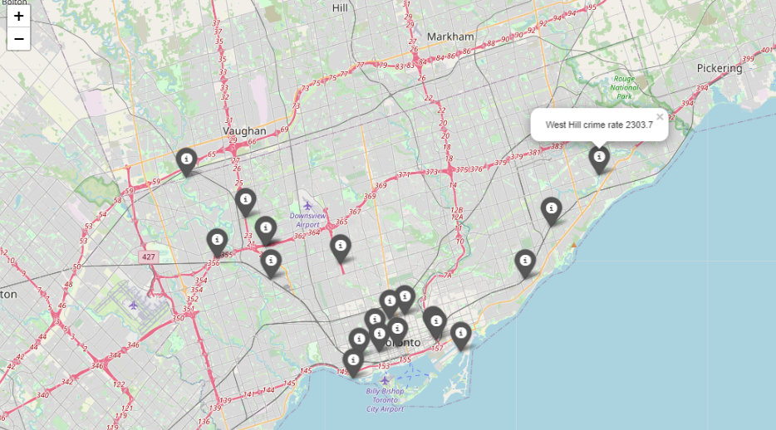
High CRIME Rate Neighbourhoods - Folium MAP
20 Neighbourhoods of Highest Crime rate
Bay Street Corridor, Moss Park, Kensington-Chinatown, University, West Humber-Clairville, Humber Summit, Yorkdale-Glen Park, Regent Park, West Hill, Downsview-Roding-CFB, North St.James Town, Annex, South Parkdale, Kennedy Park, Weston, Oakridge, Pelmo Park-Humberlea, South Riverdale, Trinity-Bellwoods, Glenfield-Jane Heights

Slide 15
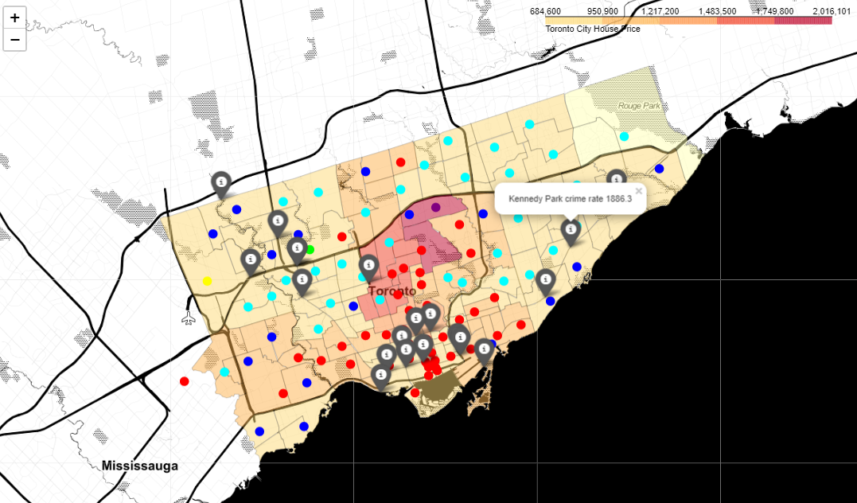
Consolidated Price LEVEL Map - clusters & Safety add-ons

Slide 16
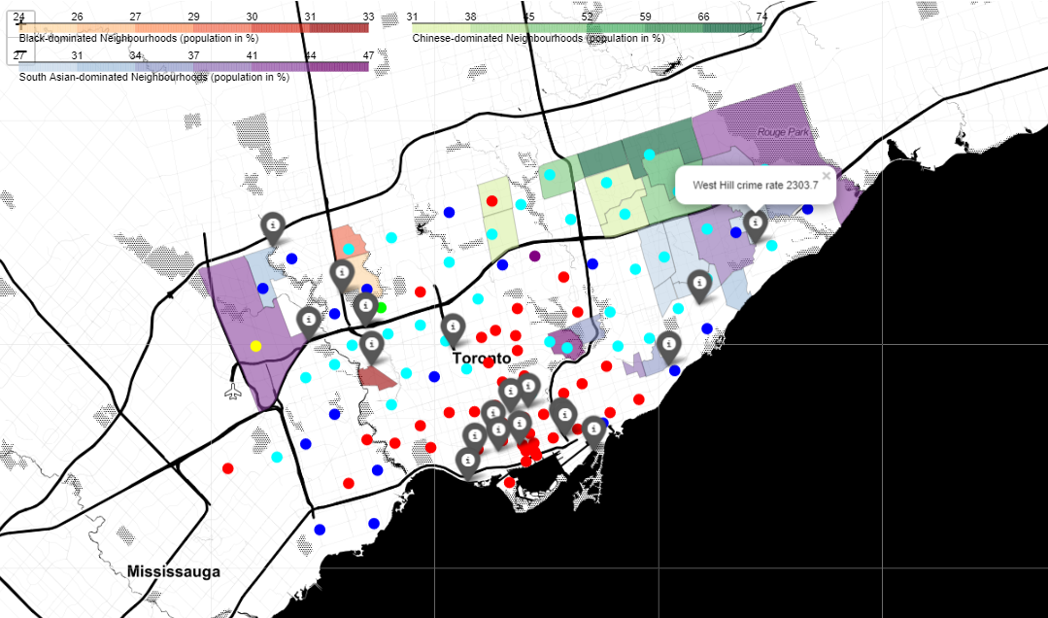
Consolidated Minority Dominated Map - clusters & Safety add-ons

Slide 17
Conclusion
CYAN cluster neighbourhoods are more favorable for living. These neighbourhoods are found to be featured with multi-functional venues around, fair house price and less crimes. While whether ones prefer to stay close to specific ethnics’ zone is a highly personal consideration.
Recommendations:
Further deepen statistical research on house price and neighbourhood features
Extend to other factors e.g. general living costs, job opportunities and educations etc.

